Slide 1
MemoryCharm
Claim Flow — UX Walkthrough
This deck walks through every screen a user sees when they scan a charm and bind a memory to it. Each slide shows where the user is in the overall journey and describes what they do on that screen.

Slide 2
The Journey at a Glance
1
2
3
4
5
6
Register
Memory Type
Upload
Protection
Secret Glyph
Sealed!
Two possible paths through the flow: • Open charm (no lock): Register → Memory Type → Upload → Protection → Sealed! (steps 1–4, then 6) • Glyph-locked charm: Register → Memory Type → Upload → Protection → Secret Glyph → Sealed! (all 6 steps) If the user has already registered, step 1 is skipped.
The following slides show each step in detail. Add a screenshot to the placeholder on each slide for the full picture.

Slide 3
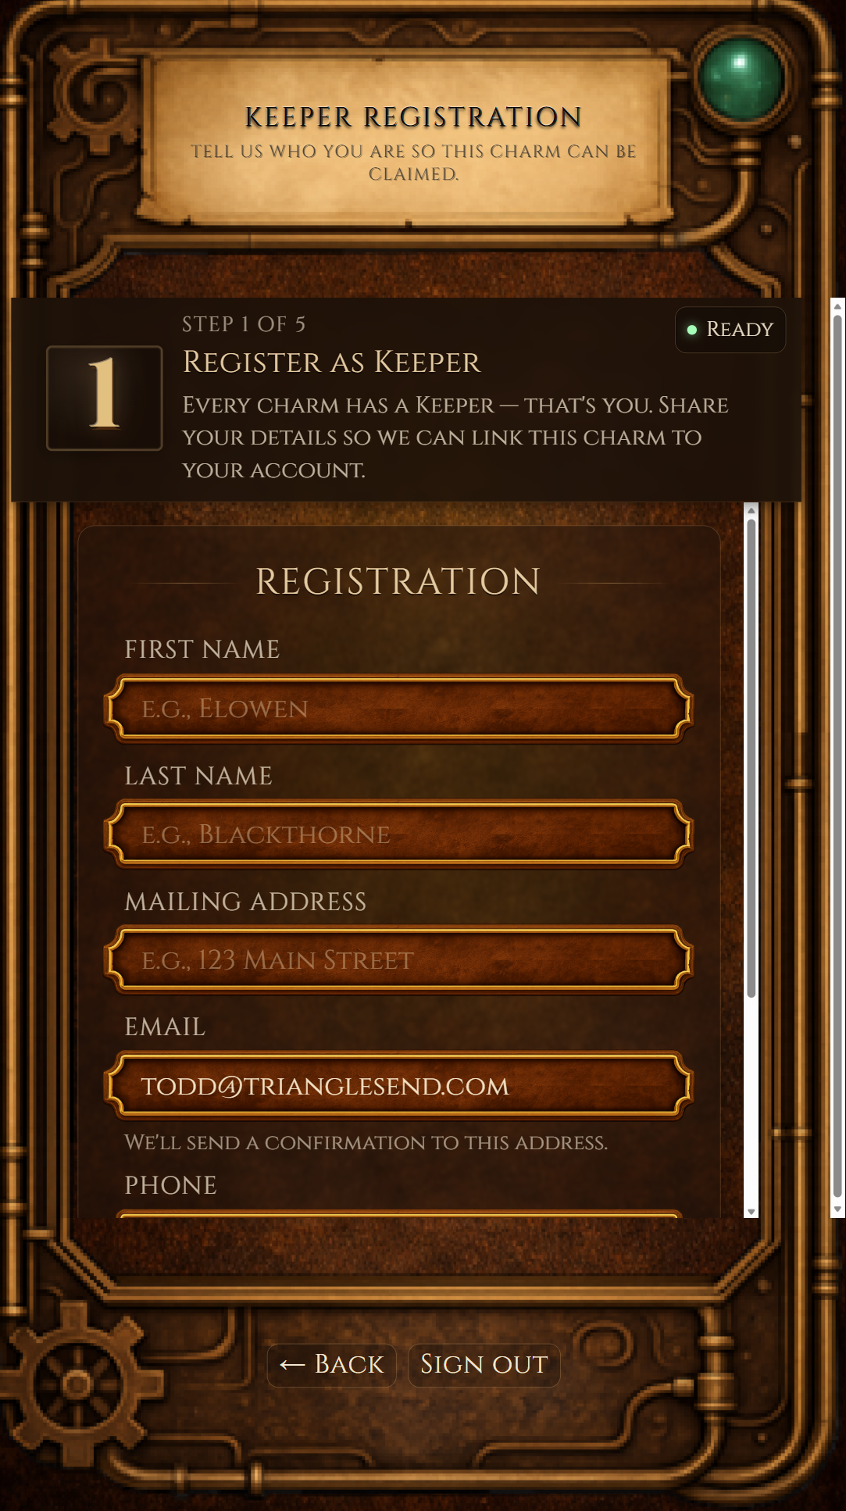
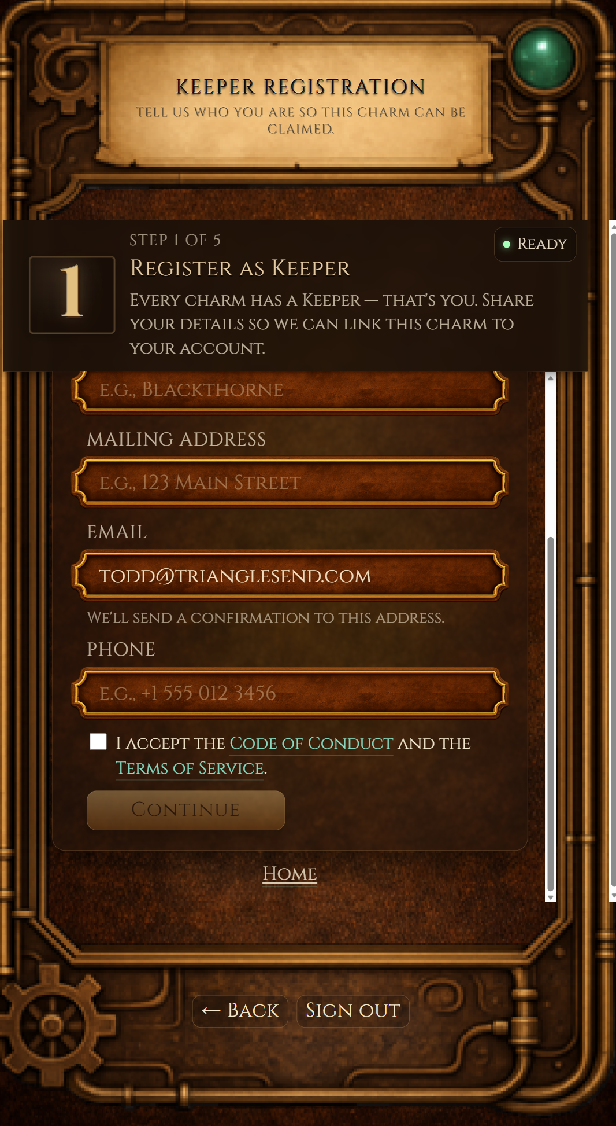
Step 1 — Register as a Keeper
▼ You are here
1
2
3
4
5
6
Register
Memory Type
Upload
Protection
Secret Glyph
Sealed!
✂ Insert screenshot here
What the user does here:
Before you can claim a charm, we need to know who you are. On this screen you'll fill in your name, address, email, and phone number. Your email is pre-filled from your sign-in. You'll also need to accept the Terms of Passage before continuing. If you've already registered in a previous session, this step is skipped automatically.
(right-click → Change Picture)

Slide 4
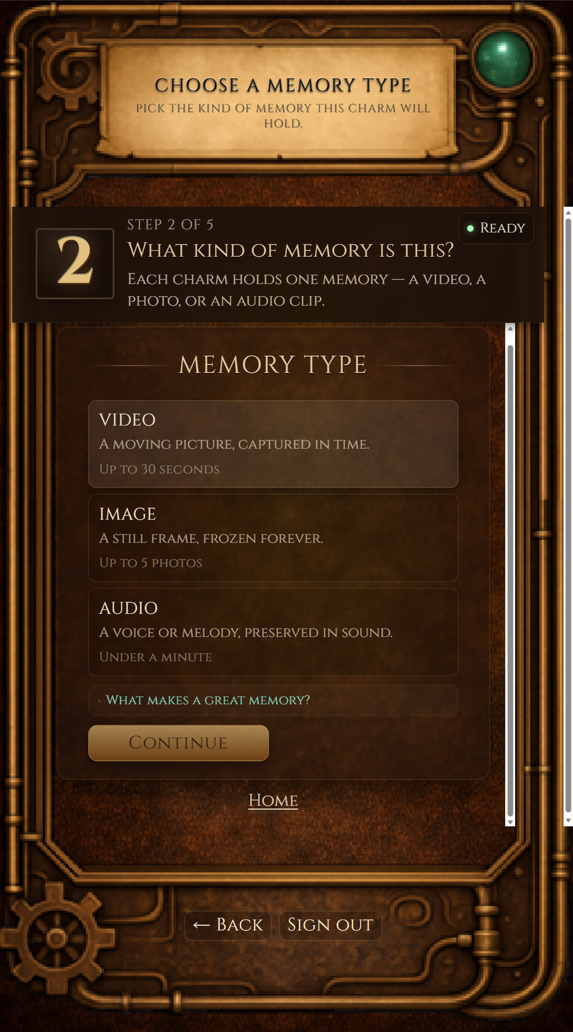
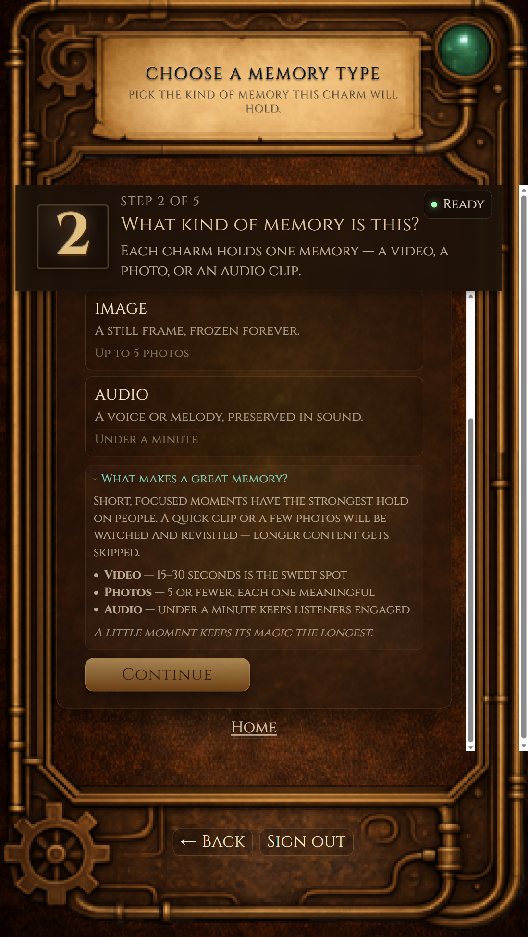
Step 2 — Choose Your Memory Type
▼ You are here
1
2
3
4
5
6
Register
Memory Type
Upload
Protection
Secret Glyph
Sealed!
What the user does here:
✂ Insert screenshot here
Every charm holds one memory. Here you pick what kind: • Video – a moving picture, captured in time • Image – a still photograph (you can add more than one) • Audio – a voice recording or melody Tap the one that matches the file you'd like to upload, then press Continue.
(right-click → Change Picture)

Slide 5
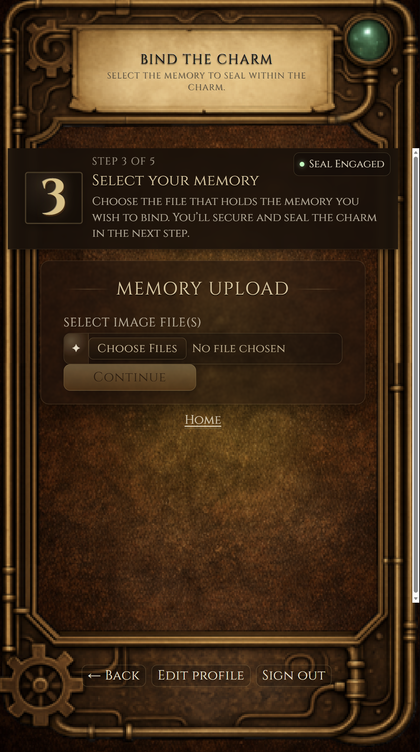
Step 3 — Upload Your Memory
▼ You are here
✓
✓
3
4
5
6
Register
Memory Type
Upload
Protection
Secret Glyph
Sealed!
What the user does here:
✂ Insert screenshot here
Now you'll select the actual file from your device. The screen shows a file picker — tap it, find your video, photo(s), or audio file, and select it. You'll see the file name and size appear on screen. Files can be up to 150 MB. Once you've chosen your file, press Continue.
(right-click → Change Picture)

Slide 6
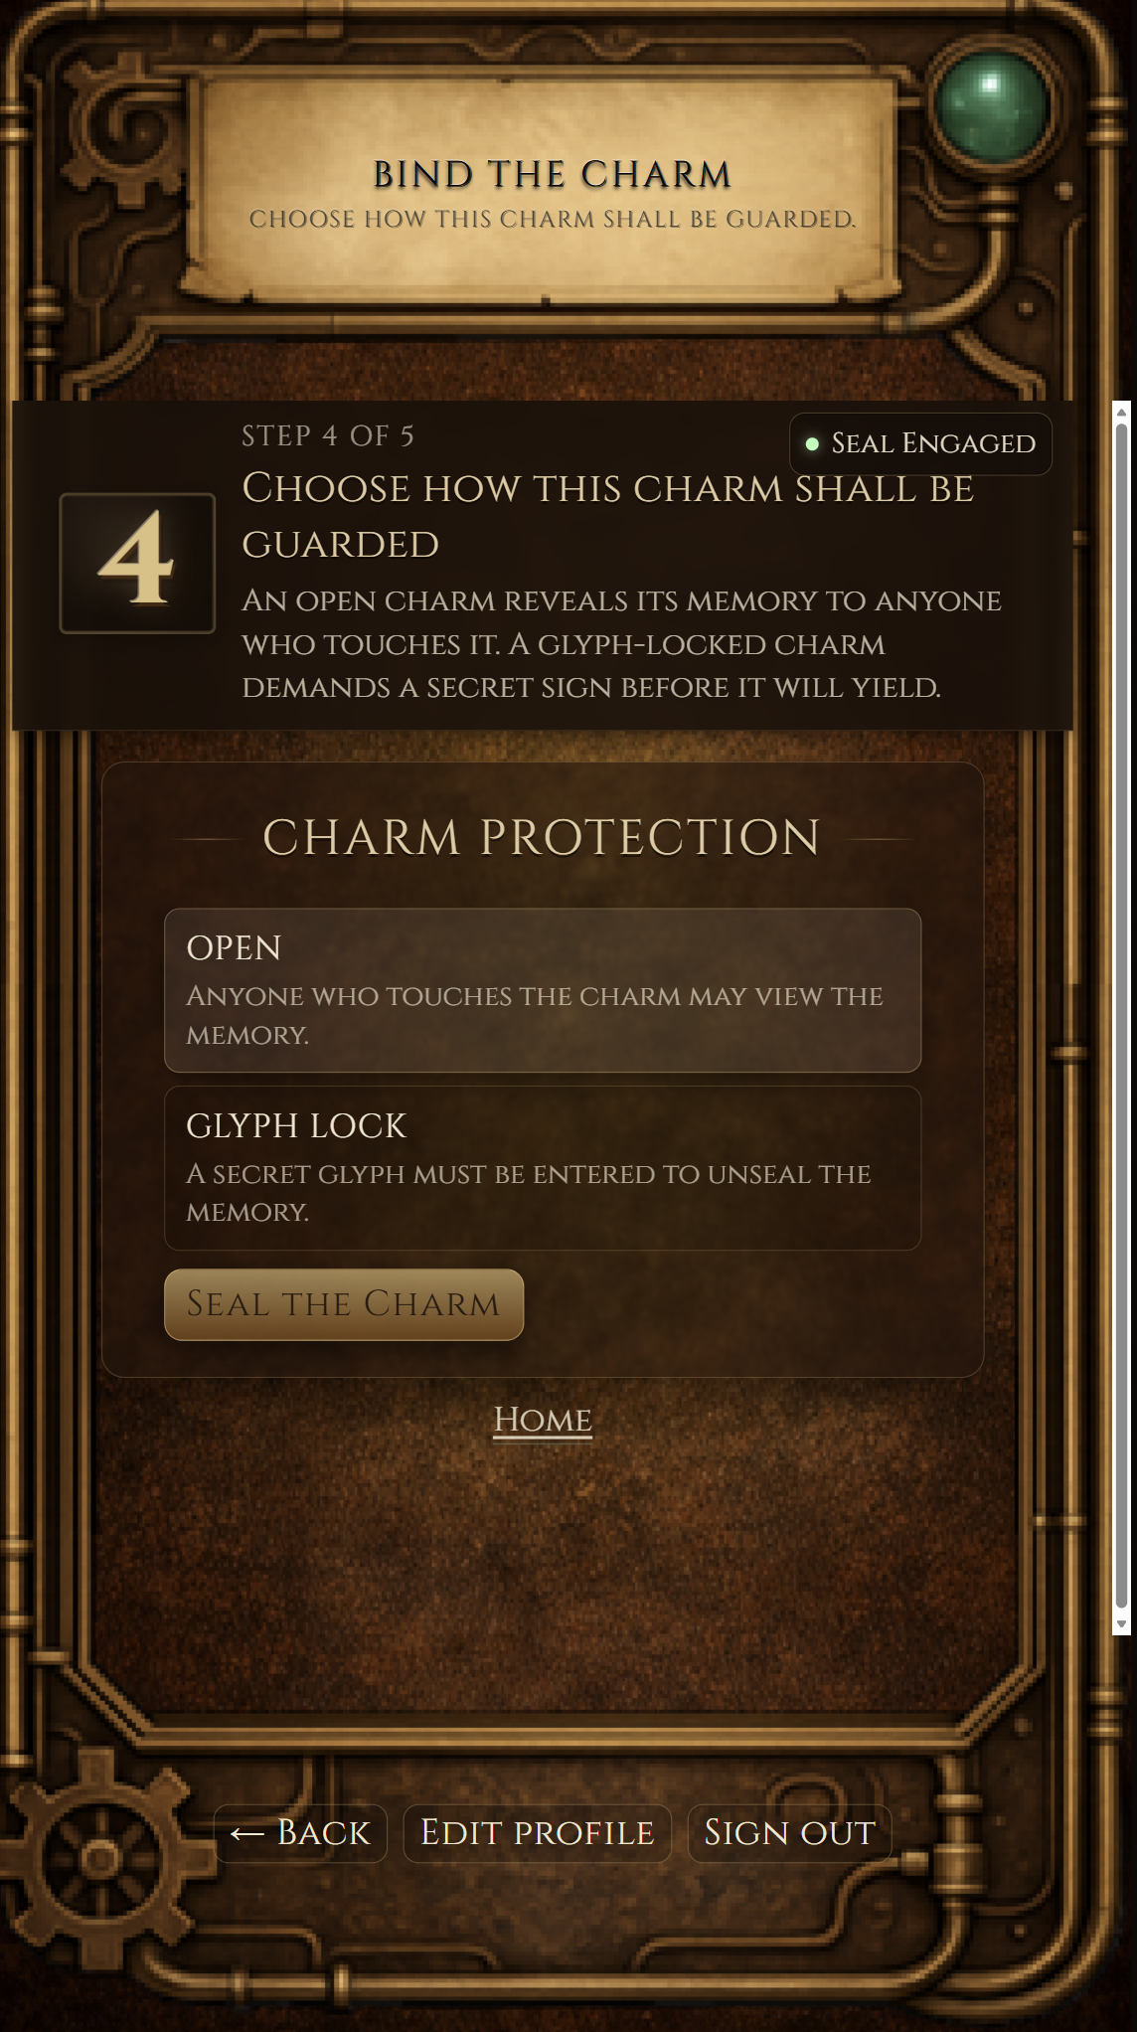
Step 4 — Choose How to Protect Your Charm
▼ You are here
✓
✓
✓
4
5
6
Register
Memory Type
Upload
Protection
Secret Glyph
Sealed!
What the user does here:
✂ Insert screenshot here
You decide who can see this memory: • Open – anyone who scans the charm can view it immediately. • Glyph Lock – the viewer must pick the correct secret symbol before the memory is revealed. If you choose Open, the charm is sealed right away and you'll jump to the final confirmation. If you choose Glyph Lock, you'll pick your secret symbol on the next screen.
(right-click → Change Picture)

Slide 7
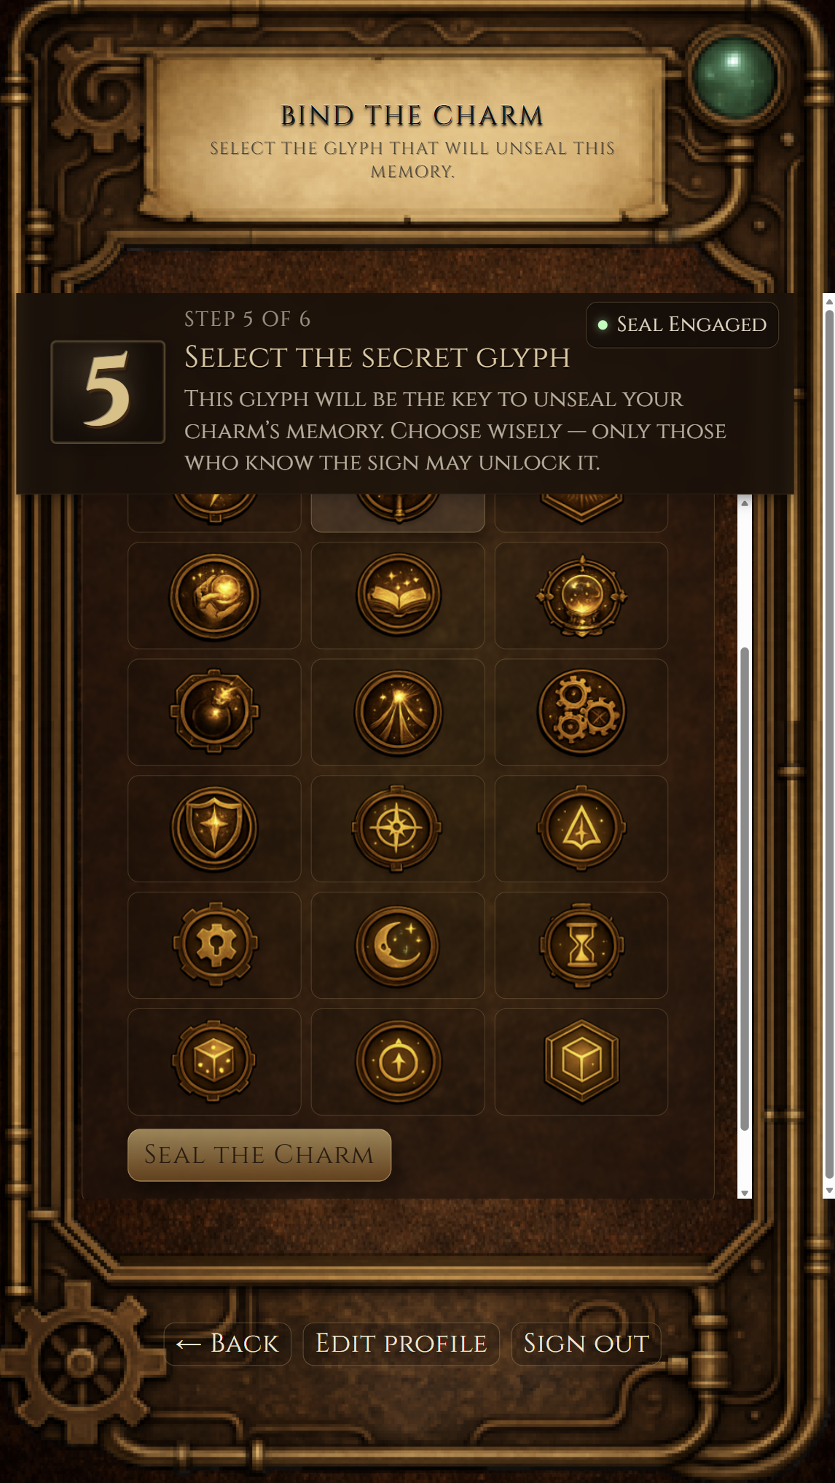
Step 5 — Pick Your Secret Glyph
▼ You are here
✓
✓
✓
✓
5
6
Register
Memory Type
Upload
Protection
Secret Glyph
Sealed!
What the user does here:
✂ Insert screenshot here
This screen shows a grid of 18 symbols — stars, hearts, moons, butterflies, and more. Tap the one you want as your charm's secret key. Anyone who later scans the charm will be shown 9 random symbols and must pick the right one to unlock the memory. They get 3 attempts. Choose something meaningful to you that the right person will recognise. This step only appears if you chose Glyph Lock.
(right-click → Change Picture)

Slide 8
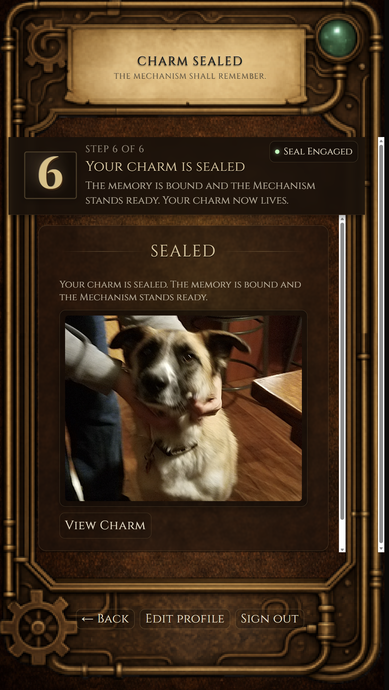
Step 6 — Your Charm Is Sealed
▼ You are here
✓
✓
✓
✓
✓
6
Register
Memory Type
Upload
Protection
Secret Glyph
Sealed!
What the user does here:
✂ Insert screenshot here
You're done! The memory has been securely bound to your charm. This screen shows a preview of what you uploaded — you can play a video or audio clip, or scroll through your photos. Press "View Charm" to see exactly what someone will experience when they scan the physical charm.
(right-click → Change Picture)

Slide 9
Thank you!
We'd love your feedback on this flow. Is each step clear? Anything confusing or unnecessary? Would you change the order of any steps?

